Slide 1


Software Architecture
Omar Pakker, Mary Gouseti, Chiel Peters, Cindy Berghuizen

Slide 2

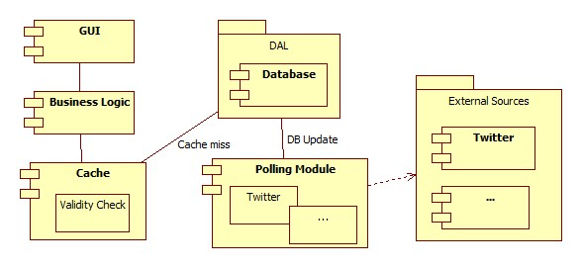
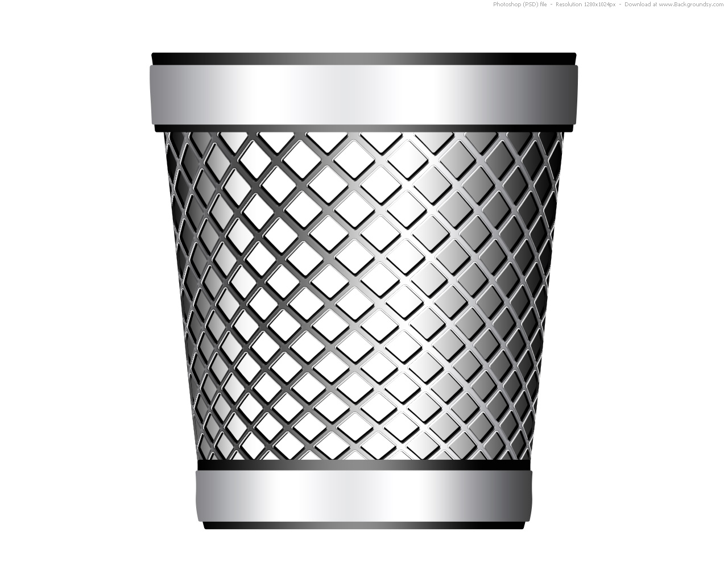
Previous proposal

Slide 3
But why?
Too general
No sticking to the architecture
Domain problems

Slide 4
So what did we do?
Divide into four tasks
  User Experience
  Competitors and Requirements
  Data storage
  Data gathering

Slide 5
User Experience
What types of customers are distinguished in the system?
What kind of interactions should each customer be able to perform?

Slide 6
Competitors and Requirements
How to deal with competition
Which are recommended rating points?
What is the format of a review?
How do the feedback and the messaging system work?
How do we handle payment and who needs to pay?
How will the reporting system work?
How can we protect our results
How do we ensure the user's privacy?

Slide 7
Data Storage
What kind of different data types is the system required to store?
How big is the data from external sources
How does the system access these different data types and what are the key quality attributes related to them?

Slide 8
Data Gathering
How is the data collected and stored?
How is the data from different external sources combined?
How is the combined data used in order to obtain a rating?

Slide 9
Decisions

